Slide 1

COSI 104a Introduction to Machine Learning
Chapter 13 – K-means
 | Instructor: Dr. Hongfu Liu Email: hongfuliu@brandeis.edu
Main source: https://www-users.cs.umn.edu/~kumar001/dmbook/index.php

Slide 2
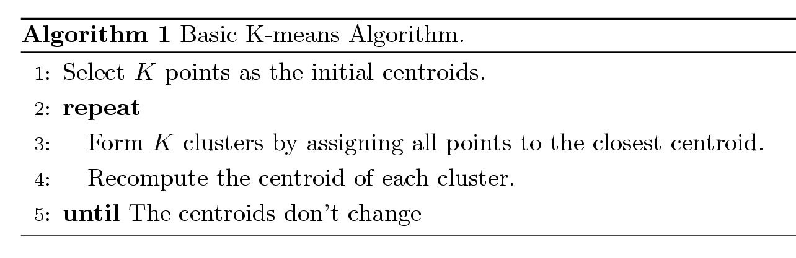
K-means Clustering
Partitional clustering approach
Number of clusters, K, must be specified
Each cluster is associated with a centroid (center point)
Each point is assigned to the cluster with the closest centroid
The basic algorithm is very simple (Lloyd’s K-means)

Slide 3
Example of K-means Clustering

Slide 4


K-means Clustering – Details
Objective function
Initialization
Initial centroids are often chosen randomly
Clusters produced vary from one run to another.
Convergence
Objective function value decreases during iteration and will stop
Guaranteed
Time complexity & Space complexity
O(InKd) & O(n+Kd)
Distance function

Slide 5
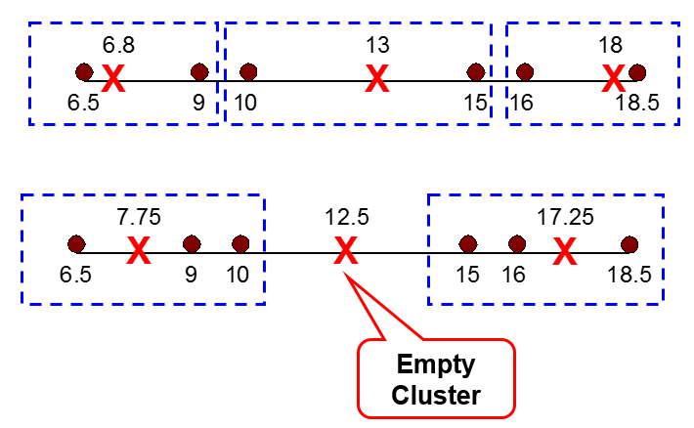

K-means Clustering – Details
Empty clusters
No data point belongs to a cluster
Solution
Randomly select one point as the centroid
Convergence guaranteed
Graph interpretation
Centroid representation

Slide 6
Practice
Run K-means on the 7 points below, where each point is a 3-dimensional vector and the cluster number is 2.
Choose sample 1 and 2 as the initial clusters
Choose sample 1 and 7 as the initial clusters
 | Feature 1 | Feature 2 | Feature 3
sample 1 | 3 | 4 | 6
sample 2 | 7 | 9 | 2
sample 3 | 2 | 2 | 2
sample 4 | 8 | 10 | 5
sample 5 | 2 | 4 | 5
sample 6 | 6 | 9 | 3
sample 7 | 2 | 2 | 5

Slide 7
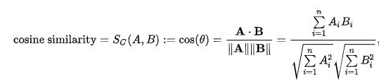
Cosine similarity

Slide 8
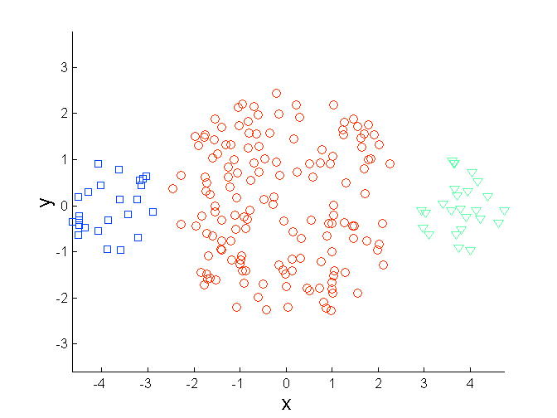
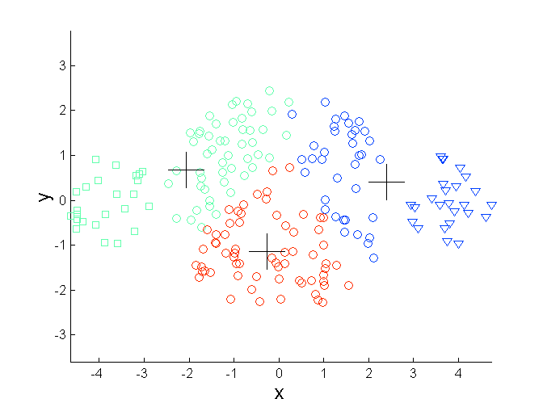
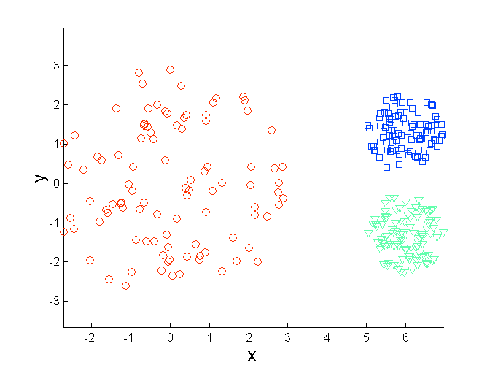
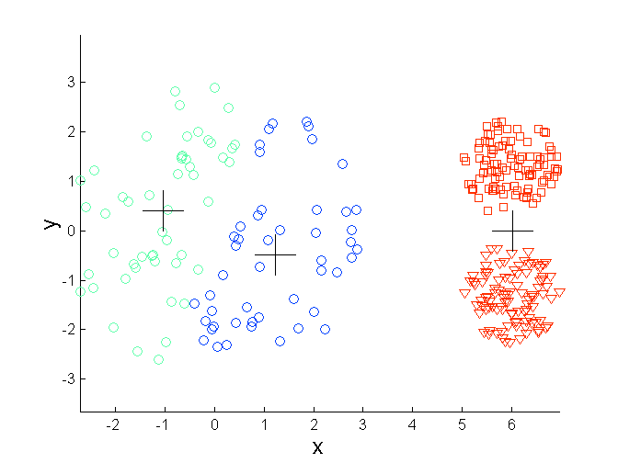
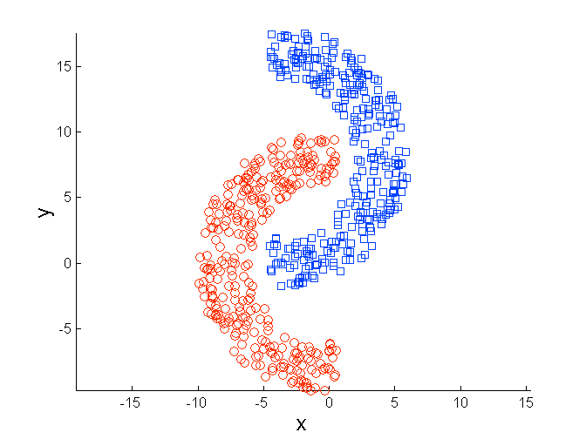
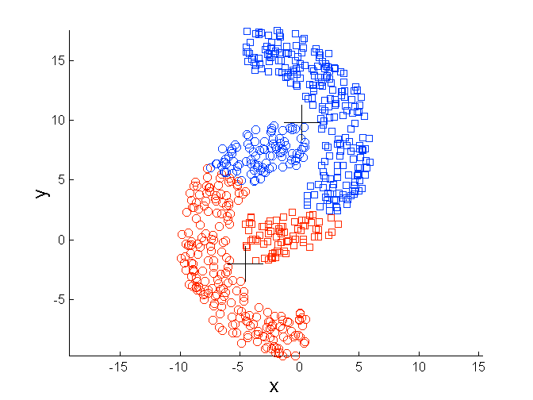
Limitations of K-means
Initialization
Data distribution
Sizes
Densities
Non-globular shapes
Outliers
Time complexity & Space complexity
O(InKd) & O(n+Kd)
Not stop

Slide 9
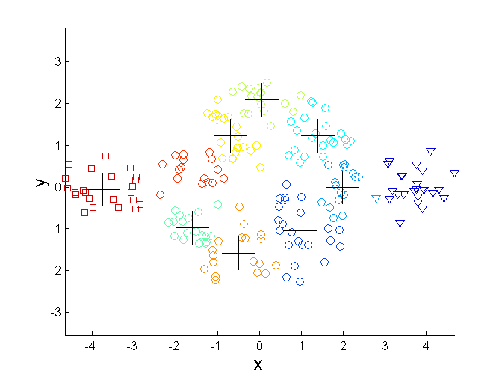
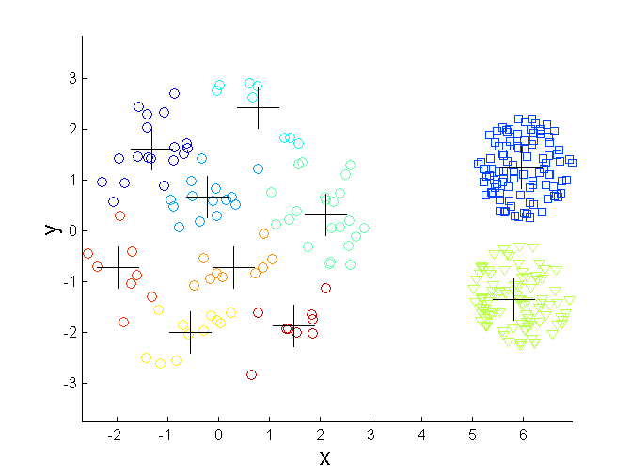
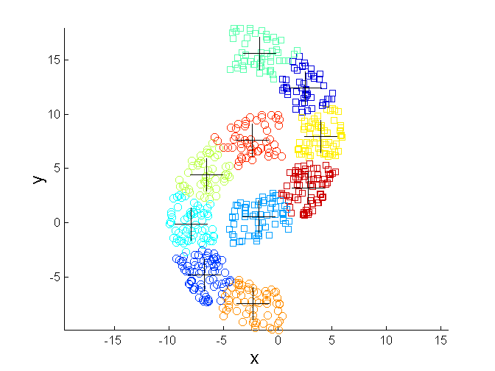
Overcoming K-means Limitations
Initialization
Multiple runs and pick up the one with minimum objective function value
K-means++
Global K-means
Data distribution
Break the big cluster via increasing the cluster number
K-means--
What else

Slide 10
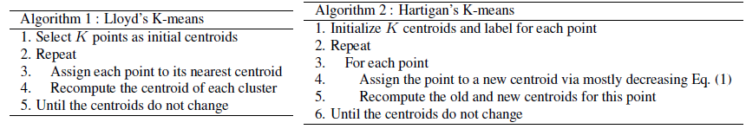
Others
Hartigan’s K-means
In the Lloyd’s K-means algorithm, centroids are updated after all points are assigned to a centroid
Hartigan’s K-means is an incremental way
Each assignment updates zero or two centroids
More expensive (really?)
Introduces an order dependency
Never get an empty cluster

Slide 11

Kernel K-means
Input of K-means
Record data
Graph data
Kernel K-means
Why kernel?
What is a kernel?

Slide 12


